Slide 2
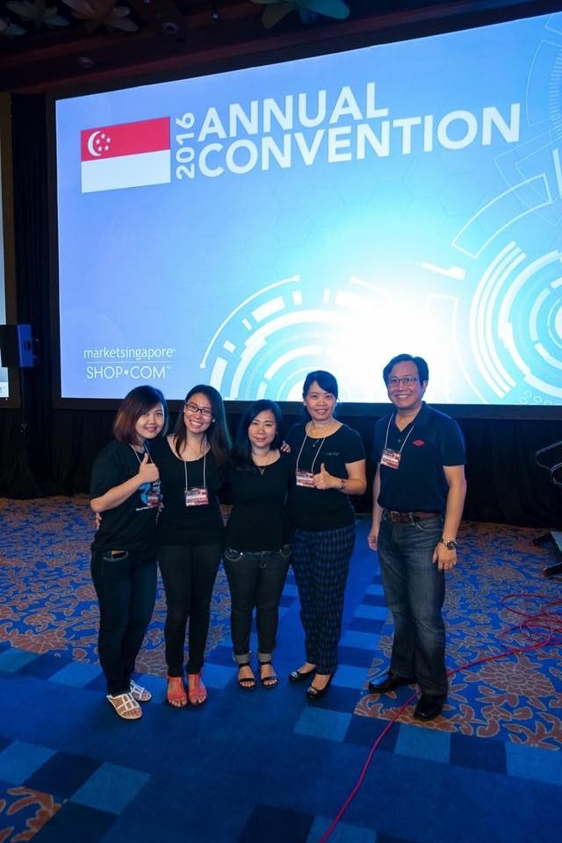
Market Singapore Annual Convention – April 2016

Slide 4
Market Singapore Leadership School – October 2016

Slide 5
Market Singapore Annual Convention – April 2017

Slide 6
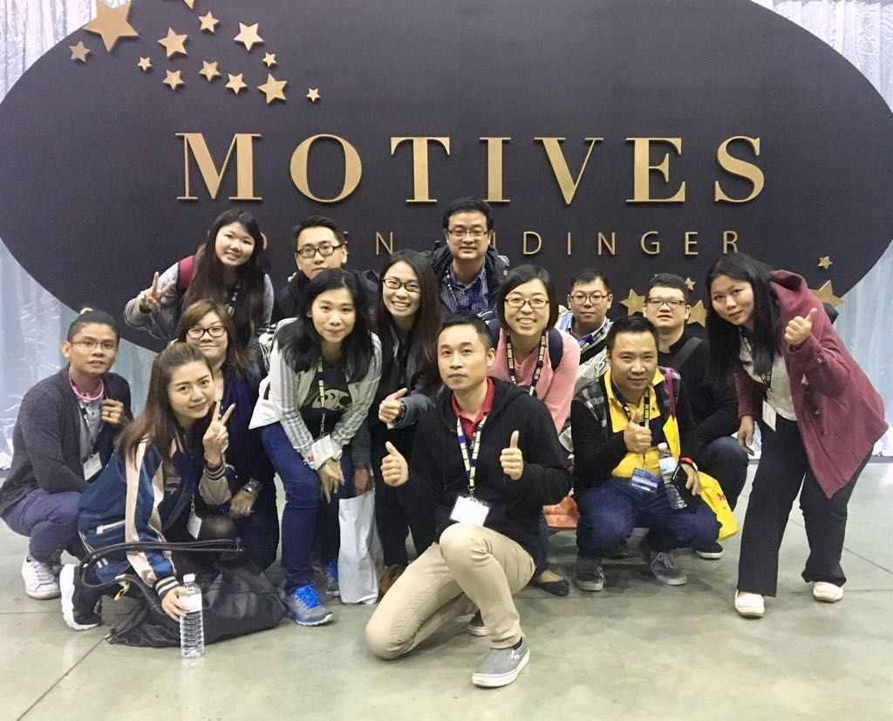
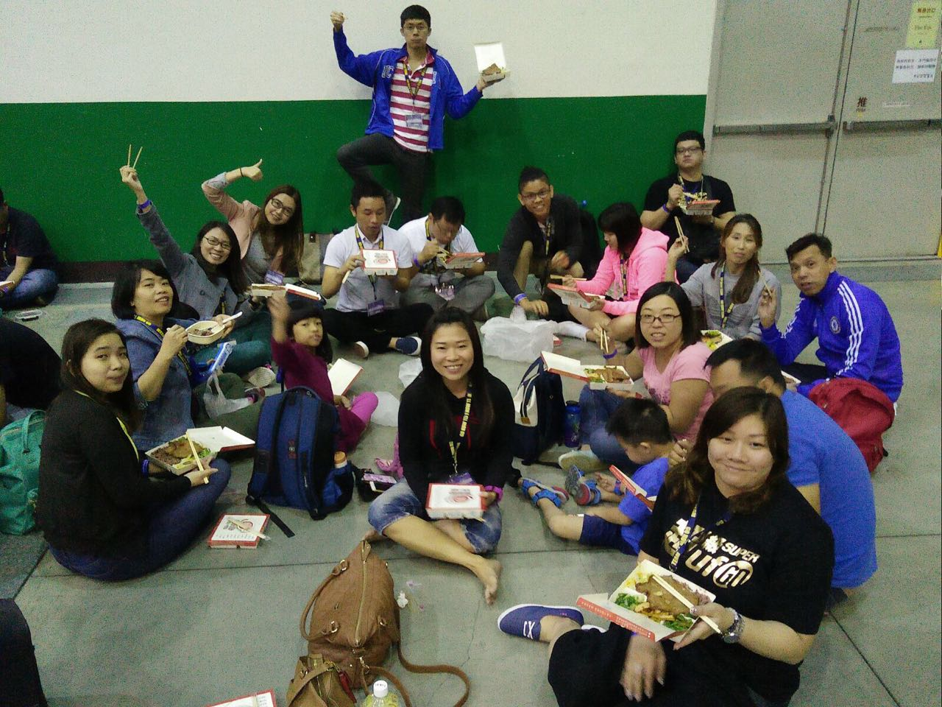
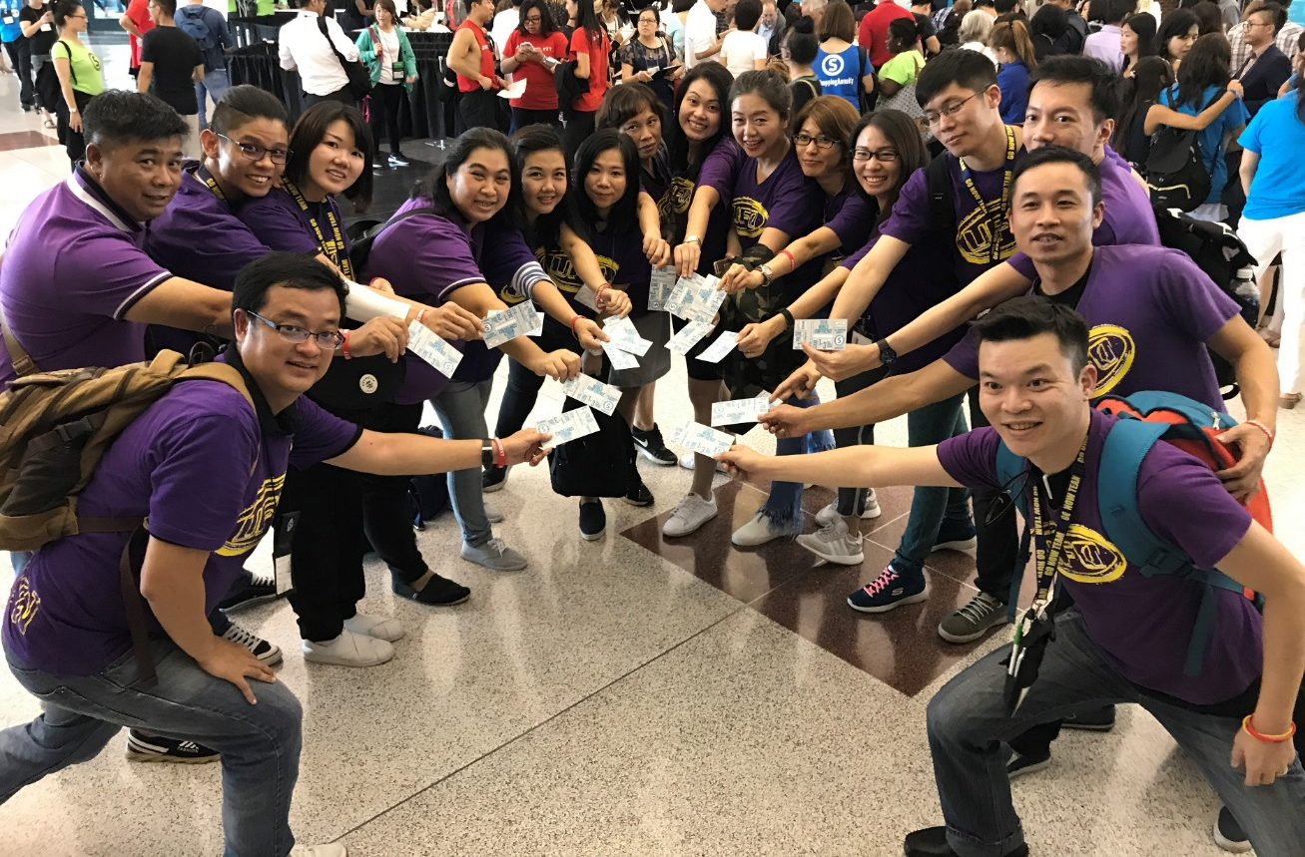
Taiwan Convention (October 2016)
Miami World Conference (February 2017)
Taiwan Convention (April 2017)
Greensboro International Conference (August 2017)

